Slide 1
Cricket League Management System
Mohith Lalita Kumar Parvataneni (001565574)
Anil Kumar Potharaju (001592990)
Eswara Sai Nath Adusumalli (001565578)
Sai Supraja Kosuri (002191644)
Sai Saketh Kosuri (002199401)
Venkata Sandeep Barla (002135635)

Slide 2
Problem Statement
Managing a cricket league is robust task for a cricket board.
Till date this event is not fully virtual. It may be difficult for players and teams to register themselves with the cricket board in certain times.
For solving this problem, we are creating a cricket league management system for the sports board which is used by the cricket board to conduct a virtual auction and manage the whole league in terms of venue selection and scheduling matches, player payment, allotment of points and declare the winners.
The whole event can be managed on a single virtual platform.

Slide 3
Proposed System
The proposed “Cricket League Management” system is an online portal which is build with a goal of managing a whole cricket league from conducting auction to declaring the winner.
Owners and players gets registered into the system and the system is available 24/7, so the owners can bid on the players at anytime from anywhere which saves a lot of their time and money.
Teams owners can use this system to track the budget/bidding amount/fee paid to the player, search for a particular player, monitor player/team performance, get venue information, perform statistical analysis of players, etc.
Players can use this system to register and take part of the auction, keep track of their statistics, get information about venues, etc.
There is also an administrator for the whole system who add owners/ players, set the bidding amount limit, decide the venues, track the auction, manage the players entry(eligibility) into the auction, etc.
The system has strong user authentication.

Slide 4
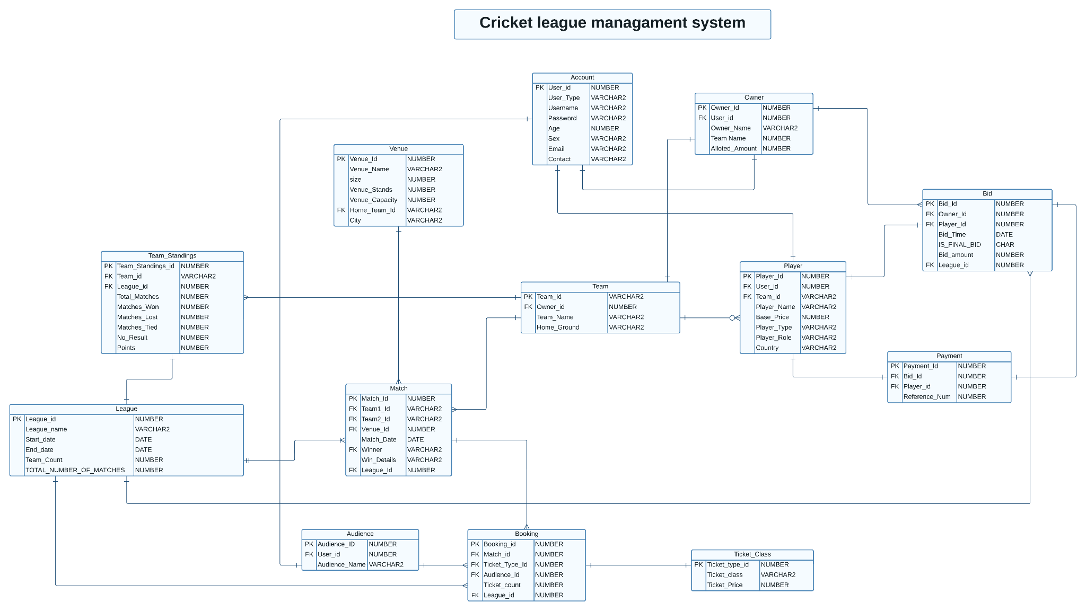
ER Diagram

Slide 5
Key Features and concepts
• The team owners who want to bid for a particular player can bid from anyplace and anytime because the system is fully functional 24/7 when auction is going on.
• Access Restrictions: Only registered teams can place bid on the players who are registered.
• The system is available for anyone who want to view to auction with only “view privilege”.
• A team owner can search for a particular player and check his availability and manage their team.
• Salaries for the players are done using the same platform.
• Every user of the system will be authenticated and they have access privileges to access the information.
• Every user can view the stats of each team, player.
• Cricket board can manage the whole event on a single platform.
• Ticket payments from the spectators to the respective stakeholders can be maintained here.

Slide 6
Team Contribution
Mohith
views - Team player
package - user_reg_auth
procedures – create or update user, authenticate user
function – list_players
triggers – assignPlayer
Created indexes
Eswara
Views - Venue_winner
function - team_venue_wins, getLagueSchedule
trigger - updateAmountAfterBid
Table creation/alter/insertion – venue, league

Slide 7
Team Contribution
Saketh
View – fixture_schedule,
Function – match_num_bookings, match_num_tickets,
Trigger – matchwinner
Table creation/alter/insertion – team, team_standings
Sandeep
View – player_payment
Trigger – removePlayerAccount, removeOwnerAccount, removeAudienceAccount
Table creation/alter/insertion – fixture, booking, ticketClass

Slide 8
Team Contribution
Anil
Function – league_revenue
Procedure – placeBid, get_player_info
Table creation/alter/insertion – user_account, player, owner, audience
Supraja
View – fixture booking,
Function – fixture_ticket_type_sold
Procedure – playerAvailability, isPlayerSold
Table creation/alter/insertion – bid, payment

Slide 9
Security - User Roles and Permissions
In this project, we have created 3 different users from admin – mohith, supraja, Saketh
Granted create session privilege to all the users from admin
We have created all the tables in Admin and gave different privileges (CRUD) on different tables to three users. Each user has different permissions on different tables.

Slide 10
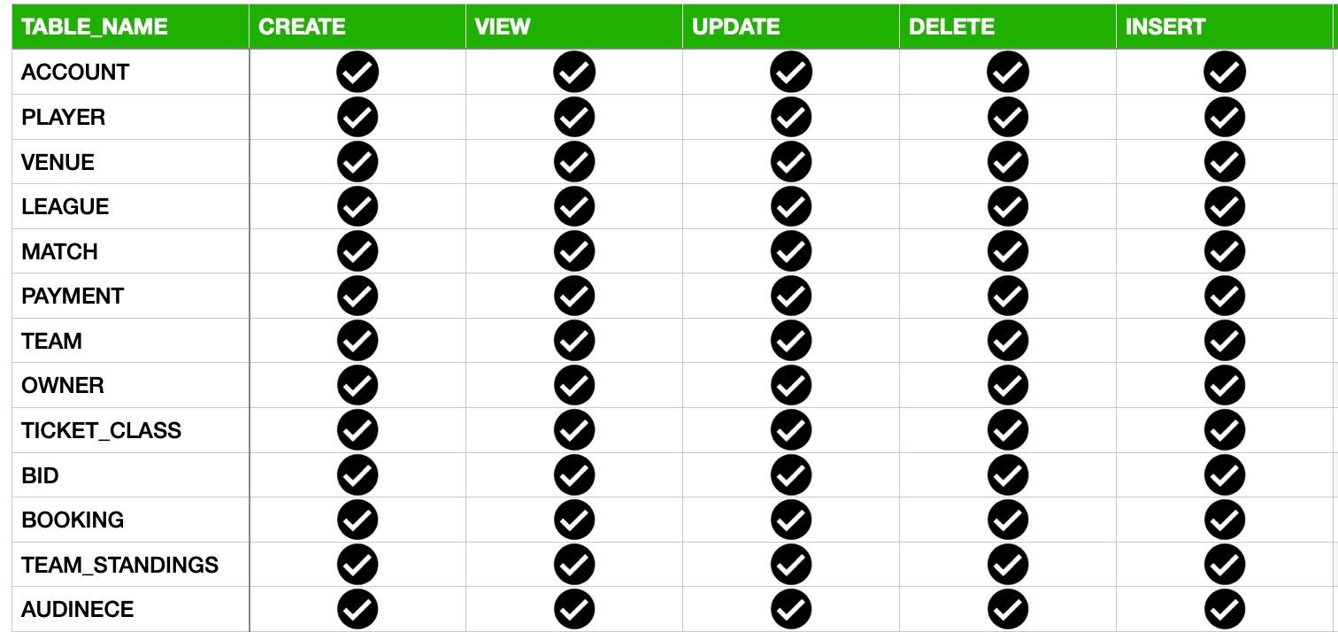
ADMIN

Slide 11
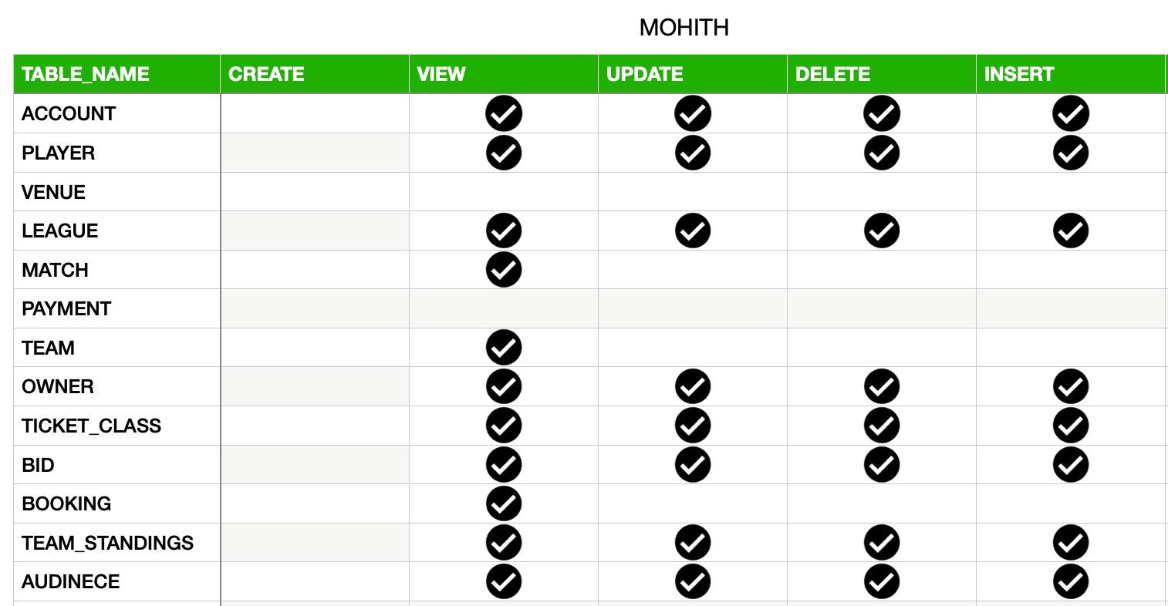
MOHITH

Slide 12
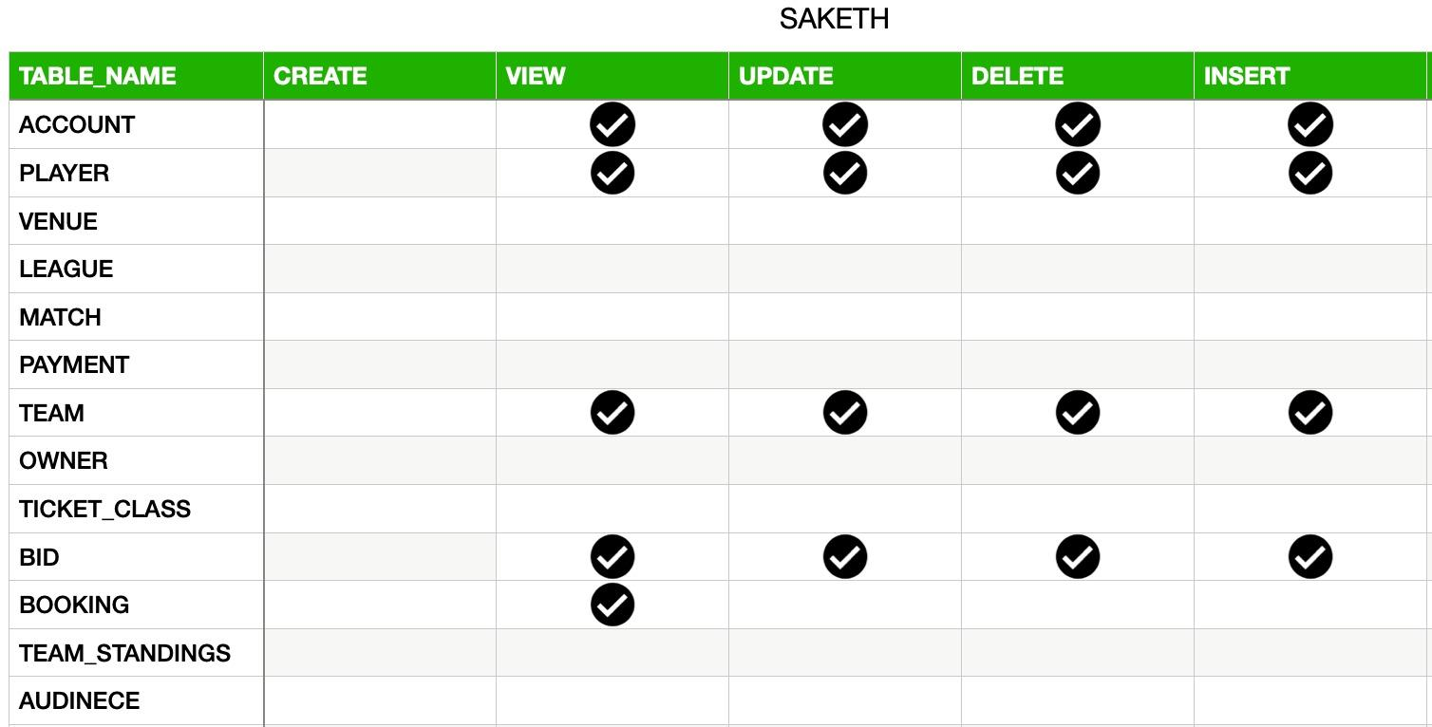
SAKETH

Slide 13
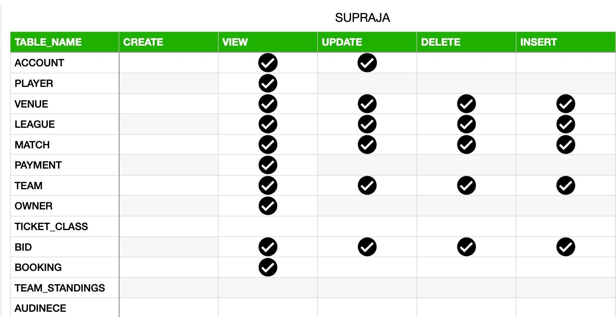
SUPRAJA

Slide 14
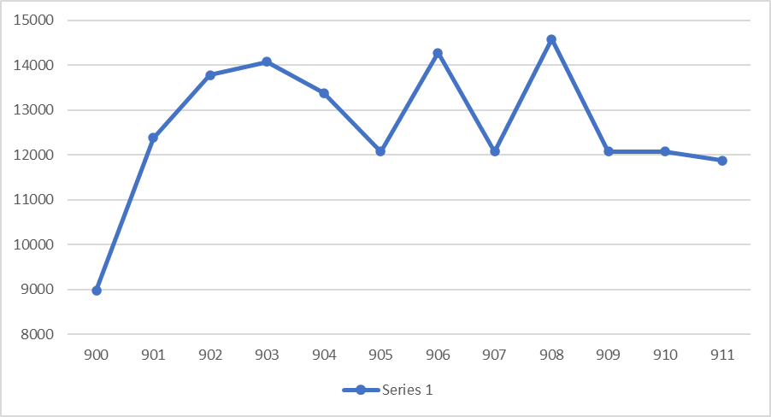
Reports
Revenue generated by each match in the league

Slide 15
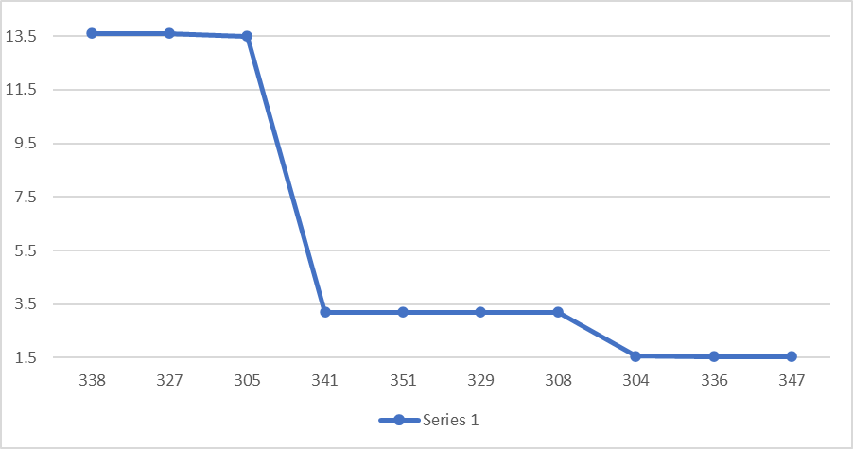
Top 10 most expensive players in league

Slide 16
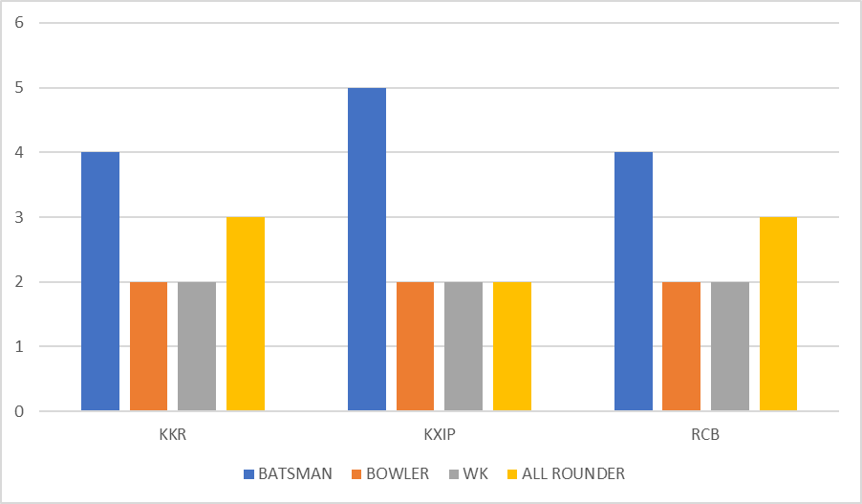
Number of players in a team, batsman vs bowler vs wk

Slide 17
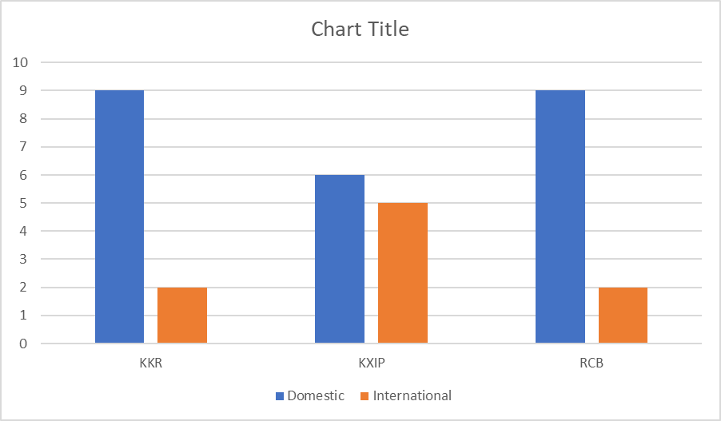
Number of players in a team, domestic vs international

Slide 18
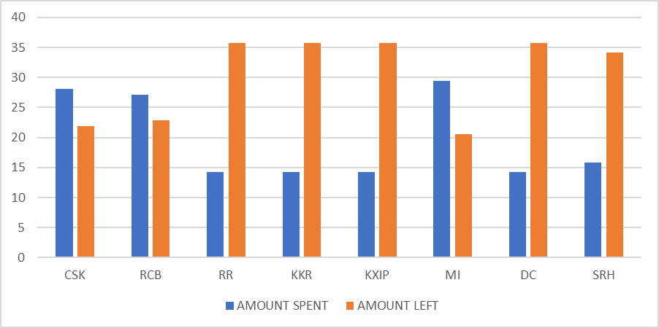
Reports to show the money spent, remaining money with each owner after bidding

Slide 19
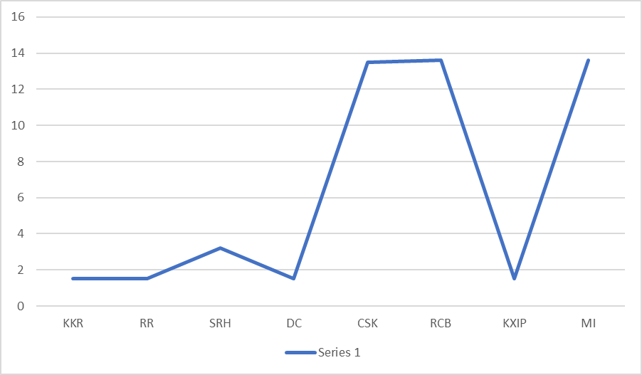
Each team and owner with their highest bid amount in the league

Slide 20
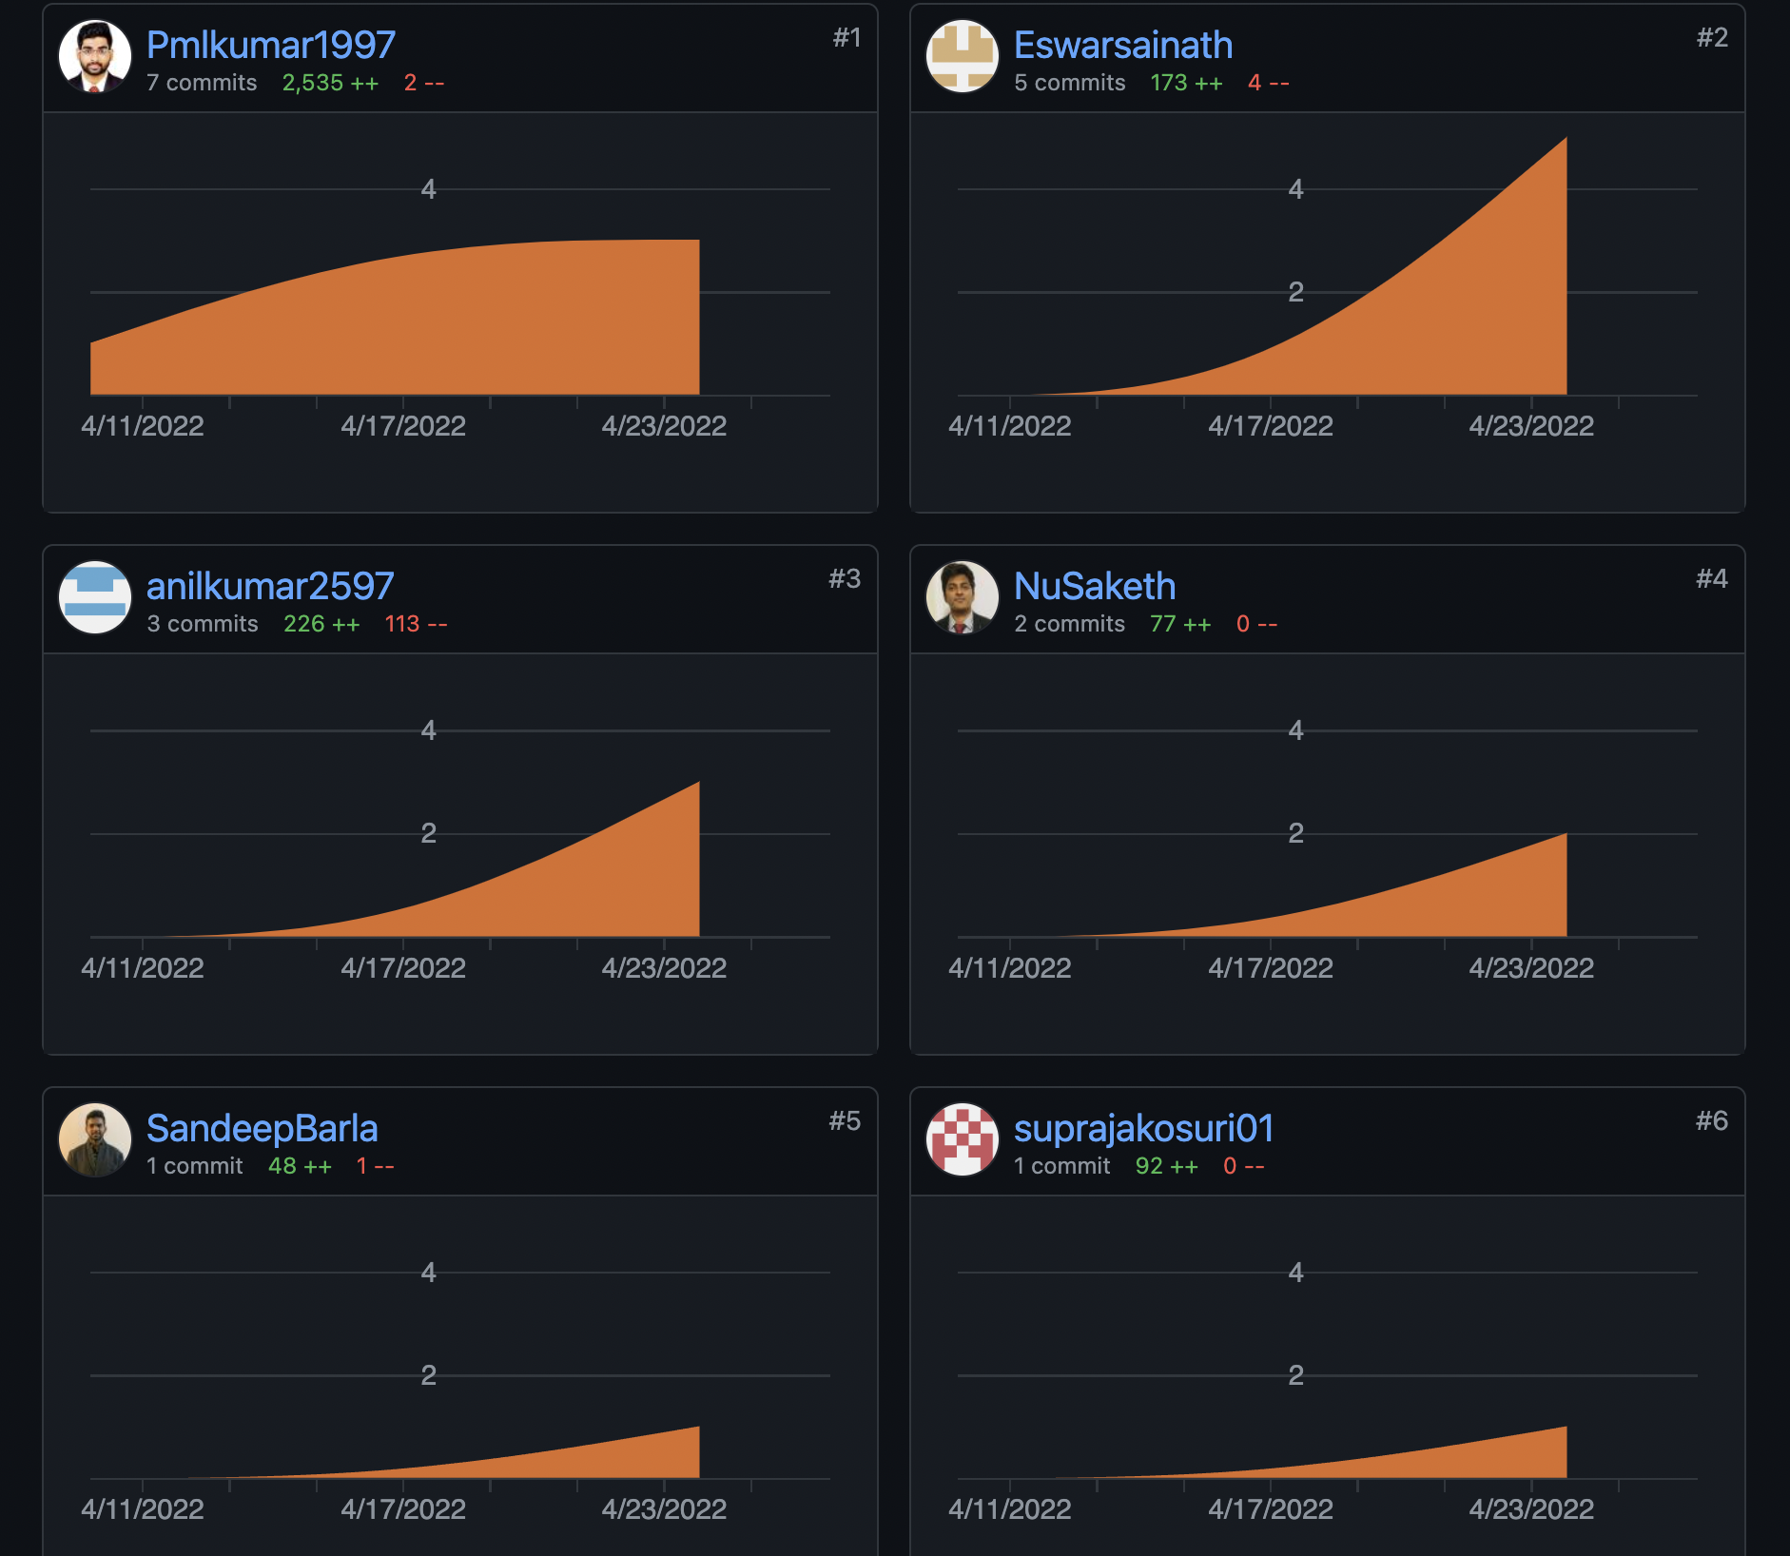
Contributors

Slide 21
THANK YOU

